Slide 1
Chapter No.2 Components of Computer

Slide 2
Computer hardware
Components of Computer

Slide 3
Computer hardware
Computer hardware is the collection of physical parts of a computer system.
This includes the physical parts of a computer such as the central processing unit(CPU), monitor, keyboard computer data storage, graphics card sound card, speakers and motherboard.

Slide 4
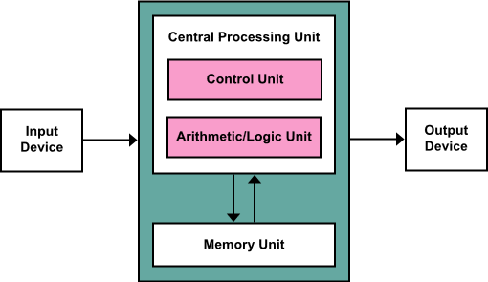
Components of Computer
The template for all modern computers is the Von Neumann architecture, detailed in a 1945 paper by Hungarian mathematician John von Neumann.
Secondary Storage Devices

Slide 5
Input Devices
This unit contains devices with the help of which we enter data into the computer. This unit creates a link between the user and the computer. The input devices translate the information into a form understandable by the computer.

Slide 6
CPU (Central Processing Unit)
CPU is considered as the brain of the computer. CPU performs all types of data processing operations. It stores data, intermediate results, and instructions (program). It controls the operation of all parts of the computer.
CPU itself has the following three components −
ALU (Arithmetic Logic Unit)
Memory Unit
Control Unit

Slide 7
Output Devices
The output unit consists of devices with the help of which we get the information from the computer. This unit is a link between the computer and the users. Output devices translate the computer's output into a form understandable by the users.

Slide 8
Memory or Storage Unit
This unit can store instructions, data, and intermediate results. This unit supplies information to other units of the computer when needed. It is also known as internal storage unit or the main memory or the primary storage or Random Access Memory (RAM).
Its size affects speed, power, and capability. Primary memory and secondary memory are two types of memories in the computer. Functions of the memory unit are −
It stores all the data and the instructions required for processing.
It stores intermediate results of processing.
It stores the final results of processing before these results are released to an output device.
All inputs and outputs are transmitted through the main memory.

Slide 9
Secondary storage
A more permanent, non-volatile form of storage is required by all computer system to save software and data files.
Magnetic tape, magnetic disks, CD-ROM (Compact Disk Read Only Memory) are all example of what is known as secondary storage.

